Slide 1



Sarah Brady, BirdLife Malta

Slide 2
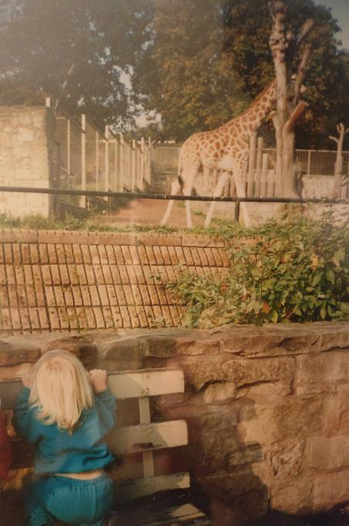
Notes:
It is great to be here today and see so many environmental educators together in one room, I have learnt so much from all of you already!
To introduce myself, my name is Sarah Brady and I am the education manager at BirdLife Malta. I have always been fascinated by the natural world from a young age as you can see! After being inspired by a childhood spent in the outdoors in the highlands of Scotland and countless David Attenborough documentaries I decided in primary 7, that I wanted to work in conservation having seriously pondered being either an oceanographer or geologist. But no, conservation was the one for me. I started volunteering for an environmental education organisation called Wildthings! in the North of Scotland aged 14 and eventually worked for them as a bushcraft instructor until I finished University.
I started off wanting to work with endangered animals studying conservation biology, until I made the decision that science wasn’t my strong point and actually the most endangered animal in the wild that I could help with my background in environmental education was humans.
Since graduating, I have spent most of my time working with BirdLife Malta, having got involved as a volunteer for a 1 year placement through erasmus and since then becoming the education manager.

Slide 3
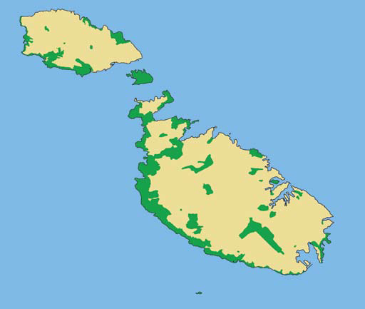
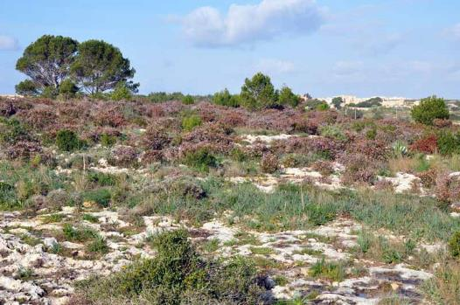
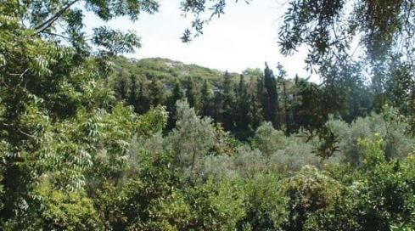
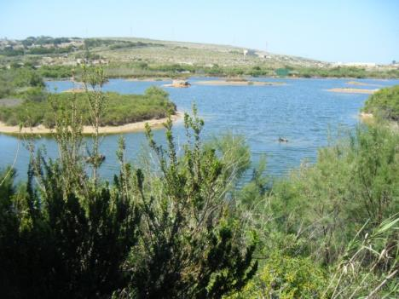
Notes:
Welcome to Malta. Malta is 316km2 . It has just over 450,000 people and about 1,400 people per square km. This map shows the 20% of the land is protected for nature conservation.
We also have the highest percentage of urbanised area in the EU at 33%. The second highest is Belgium at 13 %. The natural landscape is mostly made up of garrigue ( a shrubby habitat characterised by herbs such as Thyme, fennel and rosemary). We also have a few small wetlands and some remnant's of mostly pine woodland.

Slide 4
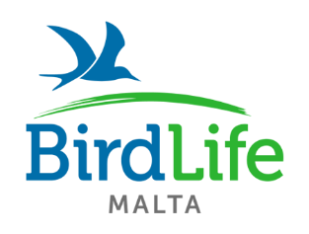
To have a country which flourishes with increased biodiversity and an increased respect towards it by the people of Malta and Gozo to live sustainably with nature.
Notes:
BirdLife Malta is the oldest environmental NGO in Malta, started in 1962 as MOS (Malta Ornithological Society). Our vision is to have a country which flourishes with increased biodiversity and an increased respect towards it by the people of Malta and Gozo to live sustainably with nature.
Malta is a small country, with an increasingly urbanised culture and countryside. There is no space that wildlife can go to take refuge. We need to change hearts and minds that nature is important, not just for the environment but also for ourselves, our health and wellbeing. This is why one of BirdLife Malta’s core strategies is education.

Slide 5
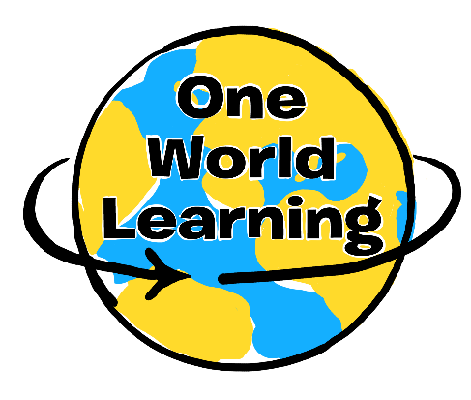
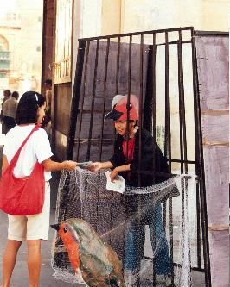
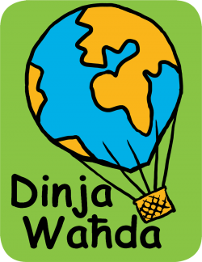

Biodiversity
Sustainability
and
Notes:
Our education programmes started with campaigning about Robin Trapping, in which wild robins are caught in small cages for pets. Here you can see our current CEO, Mr Mark Sultana as a child in Valletta the capital city. This was one of our first successful campaigns and saw the eradication of robin trapping.
Although we do a lot of non- formal education, I am going to focus on our schools programmes.
Dinja Waħda is BirdLife Malta’s flagship education programme which means ‘One World’ in Maltese. It consists of an action guide with lesson plans and resources for teachers to encourage learning through nature in the curriculum. We work with ¾ of the primary schools in Malta , it all started from 1992 with our current president of BLM who was then the education officer.
This then forms part of an awards scheme where schools can win points according to the variety of different activities they will participate in. As part of this programme we have field visits for Y2 (about 3 years) up until Form 5 (upper secondary age) at our nature reserves.
Dinja Waħda has been ongoing for over 20 years and during that time we have spent a lot of time developing the best formula for engaging with schools, we didn’t always get it right and we are still developing our work. Recently we realised that according to the latest research experiential learning outdoors is the most effective way of engaging children with nature but a lot of our activities were more arts and crafts based to be easily used in the classroom. We are now undergoing the process of building a culture of outdoor learning in schools, trying to build the bridge between outdoor and classroom learning. Through which we are now delving into school grounds development work, a new area for us for which international experts has helped us to develop structures and problem solve challenges.
Throughout this process the support from our partners has been invaluable, organisations who have already gone through this process in their countries have been able to provide advice and support for us in facilitating this change. Likewise we have been able to support organisations who are starting to build their education programmes and show the journey that we have been on from campaigning about trapping Robins as we saw from Mark to providing opportunities for people to build a better relationship with nature.
Through getting expertise from different international organisations, it has made our programmes more effective and we have hopefully managed to support other organisations in the same way.
One World Learning is a network which aims to provide a way to facilitate this process by expanding the Dinja Waħda programme to include action guides and case studies from different organisations and countries around Europe. Funded by Erasmus+ in 2017, OWL brought together best practises in this field from five European countries and the wider BirdLife Europe partnership. We have benefited from the experiences and knowledge that others have been able to provide, and equally we have been able to pass on our knowledge and experiences to other organisations. We are now growing the network and linking organisations around the globe to share educational resources and experience.
The name One World Learning represents two key environmental concepts: biodiversity and sustainability. As the most influential organisms on the planet, we humans are responsible for sustaining the health and richness of life on earth. Environmental issues cannot be contained between borders, therefore it is vital that we work transnationally to create effective conservation efforts.
We are a network of education professionals who believe that nature education is vital in order to inspire and empower individuals and communities to live sustainably.

Slide 6
Notes:
The enthusiasm, inspiration and hard work of these organisations have made One World Learning a reality.
The organisations are: BirdLife Europe and Central Asia communications team, Polish society for the protection of birds, the Ministry of education and employment in Malta, Learning through Landscapes from the U.K., Portuguese society for the study of birds and BirdLife Malta who were the lead partner.

Slide 7
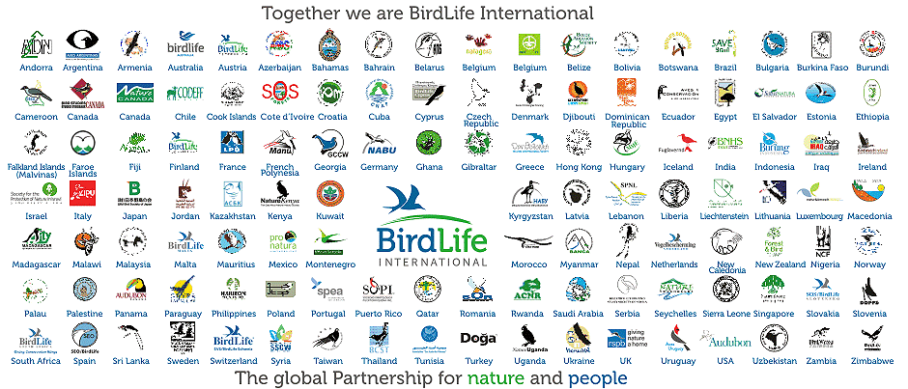
Notes:
We are also part of something bigger, BirdLife International. A global partnership of over 121 organisations who work in the conservation of birds and nature. There are so many BirdLife partners who have fantastic education programmes, and there are those who want to establish new education programmes. However, we can communicate more to share our ideas, resources and strategies to engaging people with nature.
BirdLife International partners are invited to participate in the One World Learning network

Slide 8
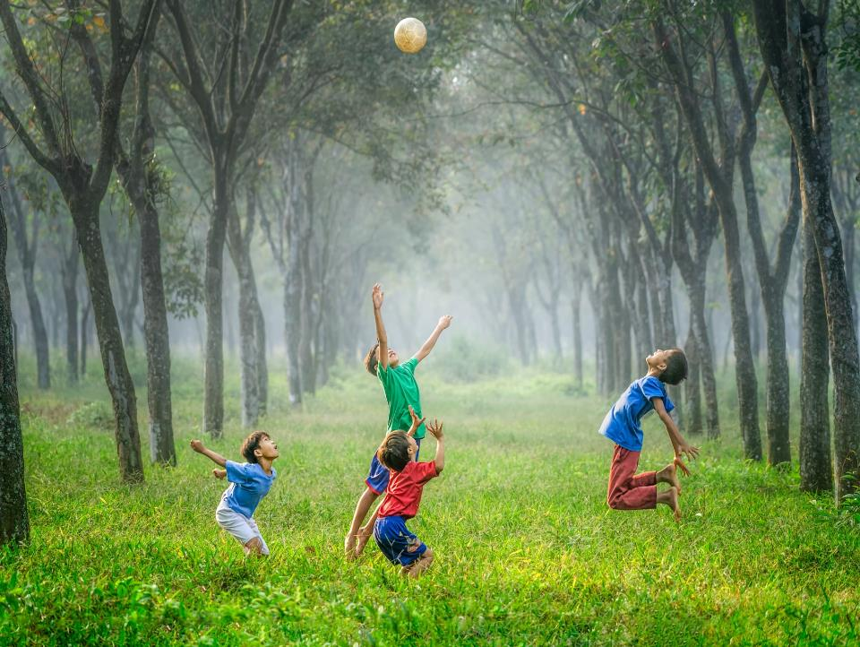
Learning through nature to inspire, equip and empower individuals and communities to live sustainably
Notes:
Our aim is to promote learning through nature to inspire, equip and empower individuals and communities to live sustainably. The way in which we want to achieve this is by advocating learning through nature and supporting the development and implementation of high quality learning through nature programmes.
We chose the terms ‘learning through nature’ to demonstrate the concept that nature is a medium through which we can learn in numerous different ways from academic subjects to soft skills development. Through spending time in nature we can all learn more about ourselves. And by applying nature in this context it provides a way for each of us to appreciate the wonder and the importance of the natural world on a daily basis.
Every single one of us has had life changing moments in nature. For me it has been spending my childhood exploring the Scottish highlands, watching wildlife documentaries of the most bizarre and wonderful creatures you couldn’t even imagine that sparked my curiosity. For others it could have been a moment where you were at the right place at the right time to watch wildlife behave unguarded and unaware that you were watching them. We want to provide opportunities for children, young people and adults to have their life changing moment in nature because only through this moment will we see those behavioural changes that lead to a more sustainable future.

Slide 9
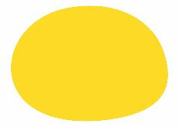
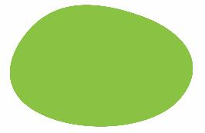
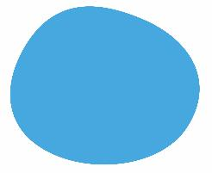


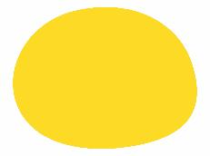
More effective
Professional Development
Build a reputation
Why Collaborate?
Share knowledge, experience and learn from others
Improve quality
Global Vision
Notes:
Why should we collaborate? We can share our knowledge, experience and learn from others which will enable us to be more effective, improve the quality of our programmes and provide opportunities for professional development. We can build the reputation of our organisations and promote collaboration.
Not only that, we contribute to a global vision for nature education. There is power and strength in the combined knowledge and experience of many and through working together we can inspire change through nature education that leads to a more sustainable future.

Slide 10


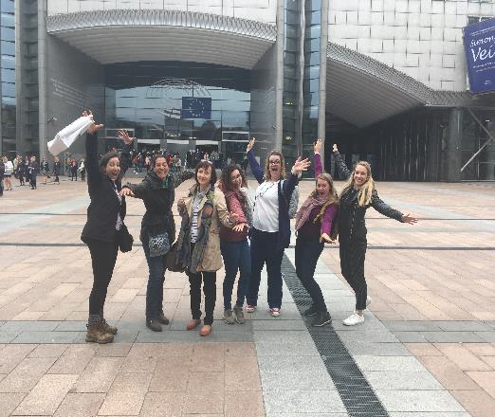
How does it work?
Coordinators Working Group
Partners
Notes:
So, how do you get involved? There are two different ways to do so, for BirdLife Partners the coordinators working group or becoming a partner are applicable and for external organisations or individuals you can become a member.

Slide 11

Partners
Join the network for free to:
Access all of our resources and educational content
Participate in webinars and events
Share your stories and experiences in nature education.
Notes:
Become a partner for free to access all of our educational resources. For example our U.K. partner Learning through Landscapes have developed a guide for organisations working with schools to develop their grounds and our Portuguese partner from SPEA has developed a guide to engaging schools with conservation and birds.
We have written case studies to give examples of how we are engaging through the curriculum, conservation and using different planning tools. There are partner profiles so you can learn more about how each organisation contributes to outdoor learning and are useful if you are looking for international partners. We will be hosting webinars and events as part of the network and you will be invited to share your case studies, resources and build a partner profile.

Slide 12
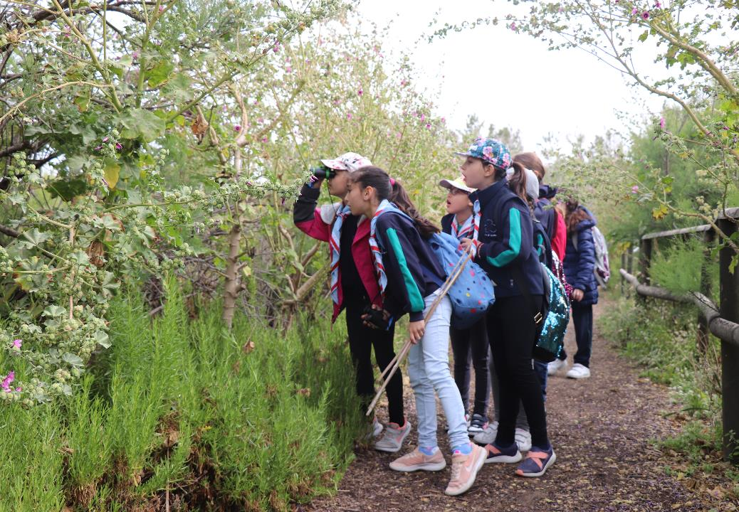
Our education resources…
Engaging schools with nature
Exploring the Science of Birds
Activities for Young people
Nature Education: What are we doing at home and abroad?

Slide 13
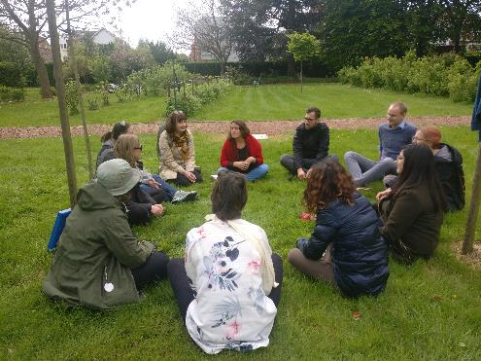
Webinars and Events
8 events across 5 different countries
Teacher Training
Environmental Educators conference

Slide 14

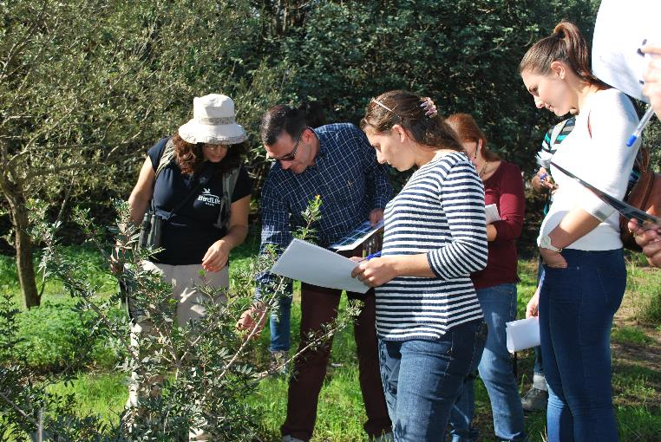
Share!
Notes:
Membership is open for all environmental and educational organisations and professionals working in this field who are not part of the BirdLife partners. This will enable us to work in partnership with schools or universities, youth groups, other NGO’s and networks to bring in new expertise and ways of engaging people with nature.

Slide 15

There are three simple steps to join for free:
Fill in the form: http://www.owleducation.org/contact-us/get-involved/
Receive a confirmation email
Reply with your logo/photos for your partner profile, and signed agreement for joining the network.

Slide 16



www.owleducation.org/getinvolved
owleducation@birdlifemalta.org
https://www.facebook.com/OWLOneWorldLearning/
#oneworldlearning
Notes:
To join the network as a partner all you need to do is fill in the form on the get involved section of our website. You will then be automatically included as a partner and the information you provide will be used to build your partner profile to be added to the website.
If you are interested in being part of the coordinating working group, just send us an email at owleducation@birdlifemalta.org or have a chat with me during the conference to discuss how you would like to get more involved.

Slide 17
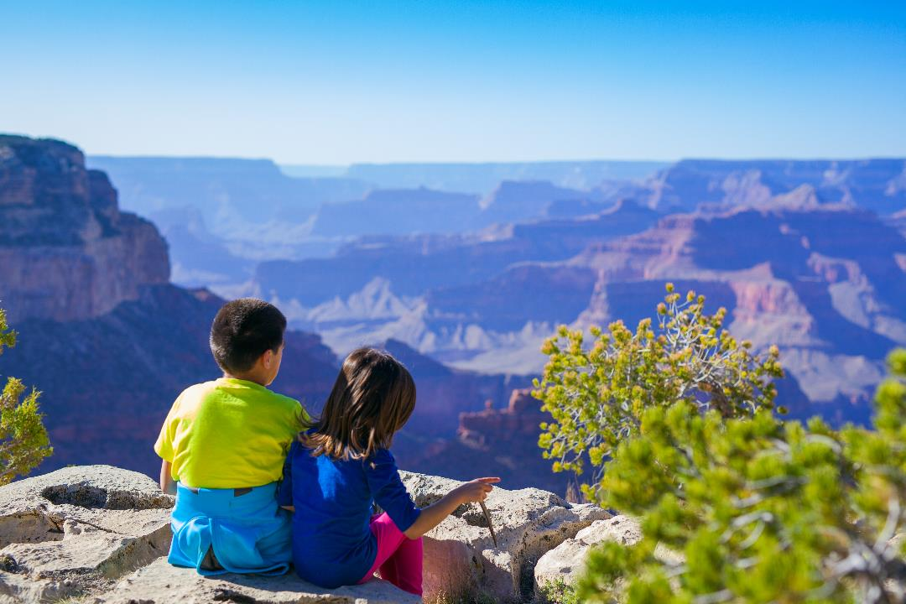
Notes:
By working together, across borders we can be more effective in engaging the next generation with nature to inspire, equip and empower individuals to live more sustainably.

